Slide 1
Statistics in physics and astronomy
These slides and some associated IDL (!) code are available at https://github.com/stephenserjeant/statistics_lecture
Stephen Serjeant
School of Physical Sciences
21 May 2025
Image/video credits: ESA unless otherwise stated

Slide 2
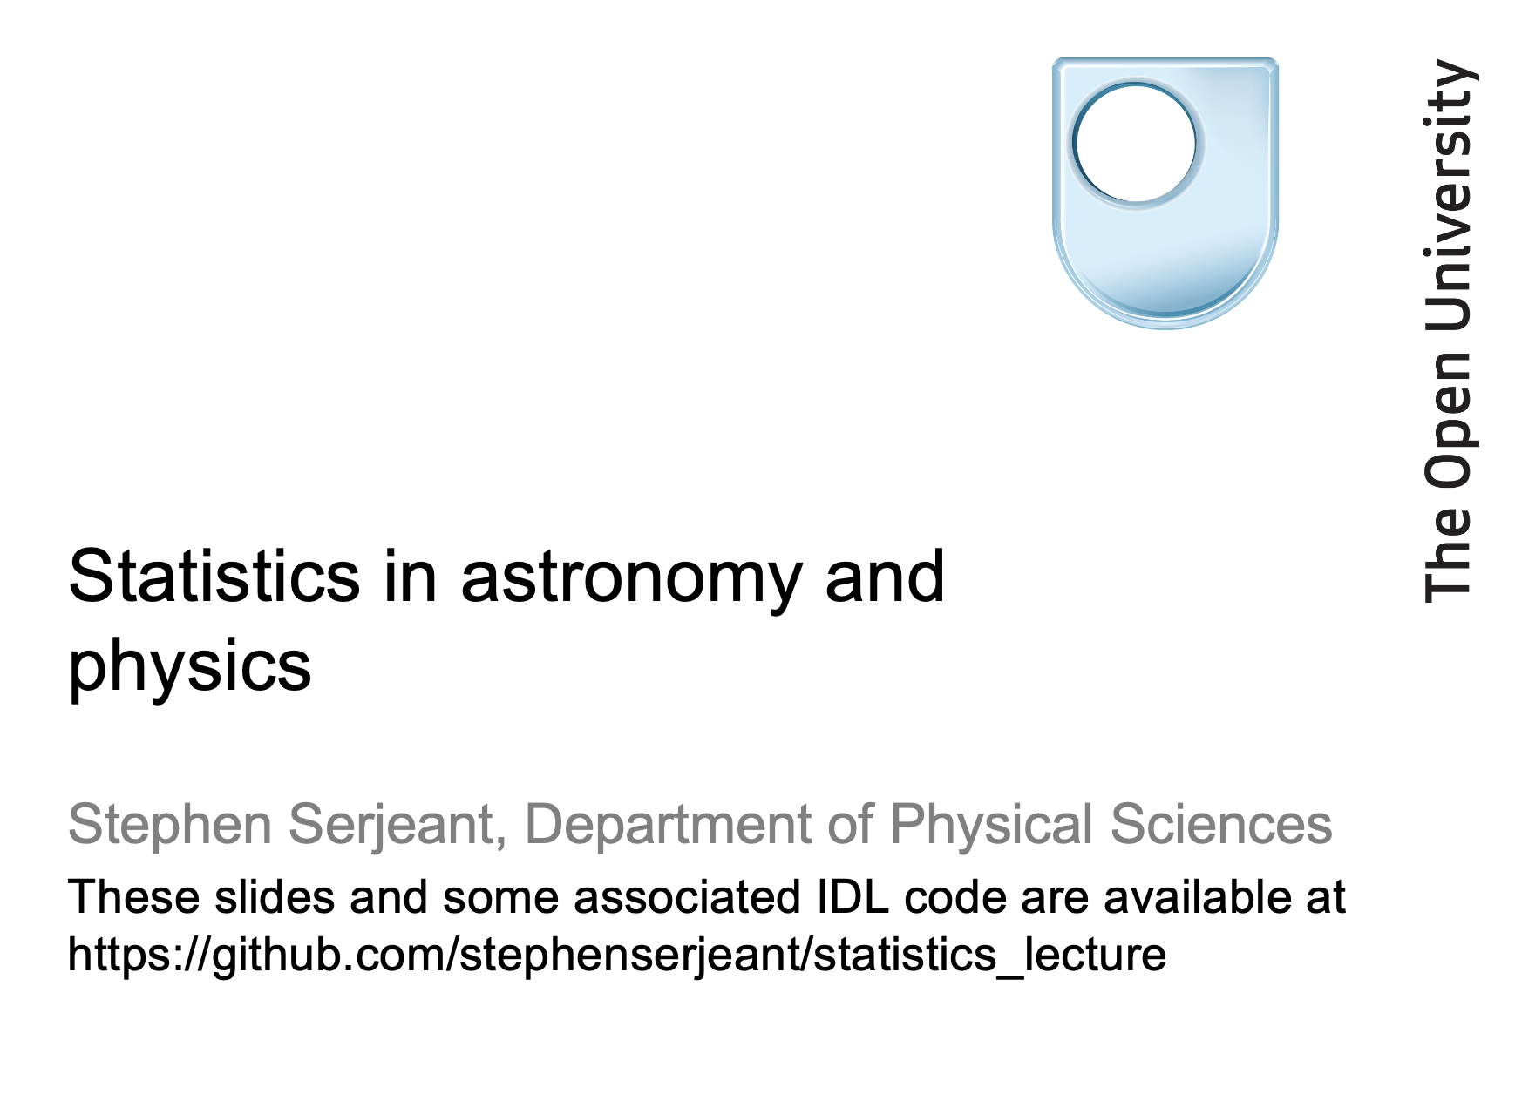
Based on this, without much modification...

Slide 3
Outline
The aim is to equip you with some handy statistical tools
that you may not have met in your undergraduate studies.
Some of this is stuff I wish I’d known as a PhD student.
Introduction and some basic stuff
Kolmogorov-Smirnov tests
Matched filters - finding blobs in images
Multi-resolution techniques, e.g. wavelets
Sampling theory
Deconvolution techniques

Slide 4
Basic stuff
I’ll assume you’re already very familiar with
what probability distributions are (or, more properly, probability density functions)
cumulative distribution functions
the Gaussian, Poisson, and Binomial distributions
χ² distribution, likelihood
expectation values, variances and covariances of independent and dependent random variables
Monte Carlo simulations
the Central Limit Theorem
Fourier transforms and power spectra
If not, go read an undergraduate statistics/maths book ASAP!

Slide 5
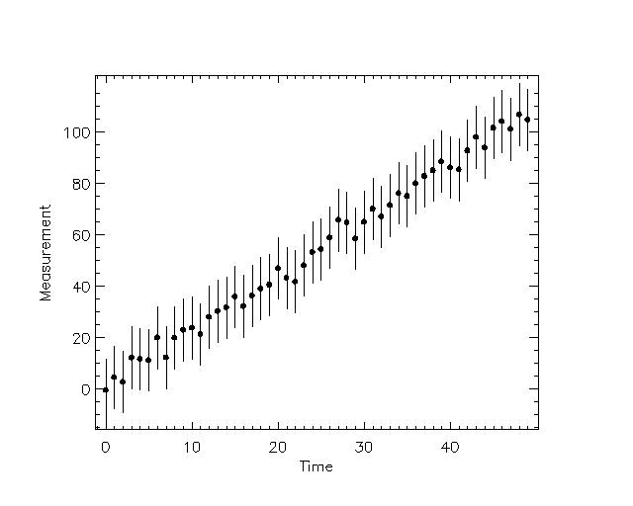
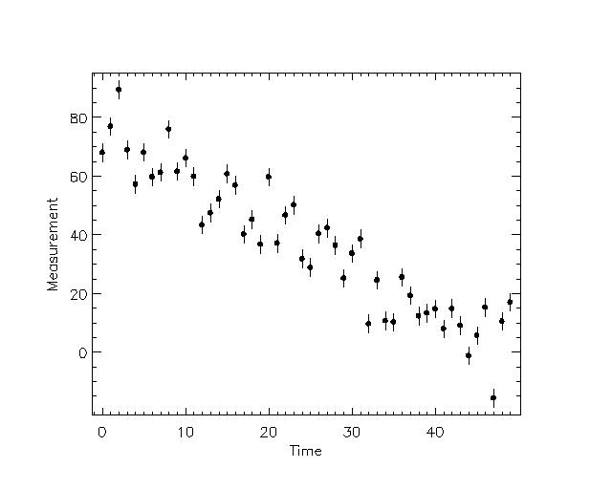
Basic stuff
What’s odd about these data streams?
Moral: use (data-model)/noise or your signal-to-noise histogram to make sure your noise estimates are realistic!

Slide 6
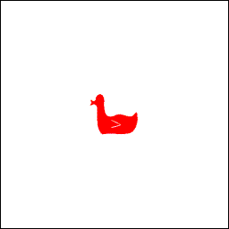
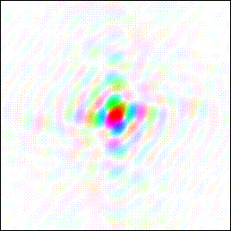
Fourier Duck and Cat
A duck and its Fourier transform (colours for phases, intensity for amplitudes)
Images taken from www.ysbl.york.ac.uk/~cowtan/fourier/fourier.html

Slide 7
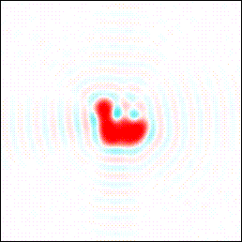
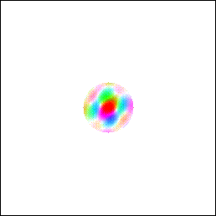
Fourier Duck and Cat
If we remove the high-frequency Fourier components and only keep the low resolution parts, we get a blurred duck. (Also note the ringing around the duck because we’ll come back to it at the end.)
Images taken from www.ysbl.york.ac.uk/~cowtan/fourier/fourier.html

Slide 8
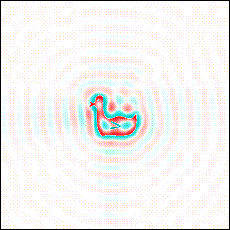
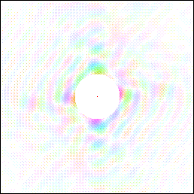
Fourier Duck and Cat
If we only have the high resolution terms of the Fourier transform, we only see the edges of the duck.
Images taken from www.ysbl.york.ac.uk/~cowtan/fourier/fourier.html

Slide 9
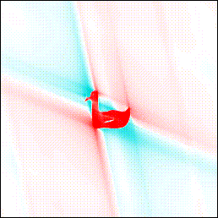
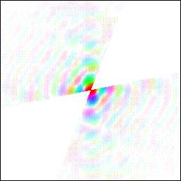
Fourier Duck and Cat
If some of the Fourier data is missing, then features perpendicular to the missing parts are blurred.
Images taken from www.ysbl.york.ac.uk/~cowtan/fourier/fourier.html

Slide 10
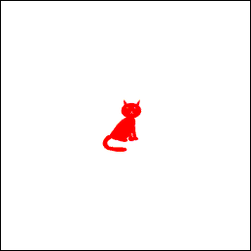
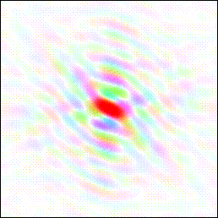
Fourier Duck and Cat
A cat and its Fourier transform (colours for phases, intensity for amplitudes)
Images taken from www.ysbl.york.ac.uk/~cowtan/fourier/fourier.html

Slide 11
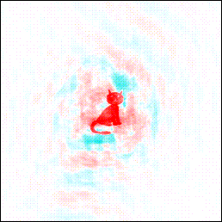
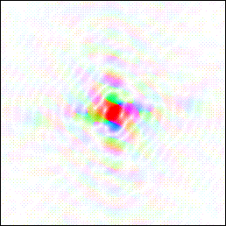
Fourier Duck and Cat
Marrying cats and ducks! Magnitudes from duck, phases from cat.
Images taken from www.ysbl.york.ac.uk/~cowtan/fourier/fourier.html

Slide 12
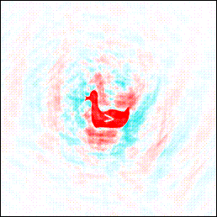
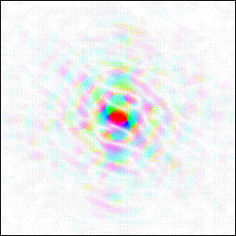
Fourier Duck and Cat
Marrying ducks and cats! Magnitudes from cat, phases from duck. This demonstrates the sorts of information in the Fourier amplitudes and phases. A Gaussian random field (e.g. primordial perturbations after Inflation) has random phases.
Images taken from www.ysbl.york.ac.uk/~cowtan/fourier/fourier.html

Slide 13
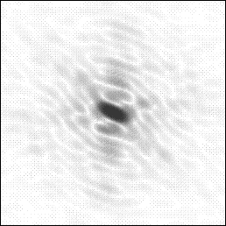
Fourier Duck and Cat
Suppose we have a Fourier transform of a cat but only have the amplitudes, but don’t have the image to the left. How can we reconstruct the image to the left?
Images taken from www.ysbl.york.ac.uk/~cowtan/fourier/fourier.html

Slide 14
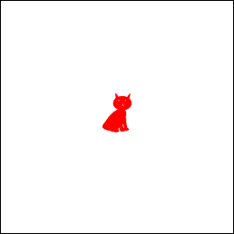
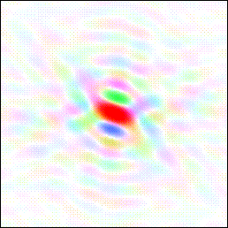
Fourier Duck and Cat
We could start with a model cat, for which we can calculate the Fourier transform. Unfortunately for us, we’ve chosen a Manx cat...
Images taken from www.ysbl.york.ac.uk/~cowtan/fourier/fourier.html

Slide 15
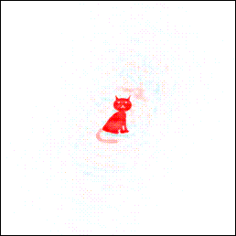
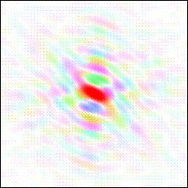
Fourier Duck and Cat
So, try the model phases plus the observed amplitudes to get a reconstructed image. Behold the tail! This is despite most structural information being in the phases, so the phases must be nearly right. But it’s at ~1/2 the correct weight. Also there is noise in the image.
Images taken from www.ysbl.york.ac.uk/~cowtan/fourier/fourier.html

Slide 16
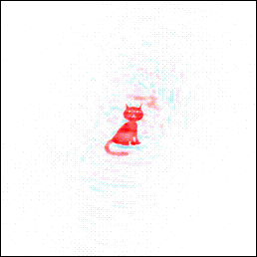
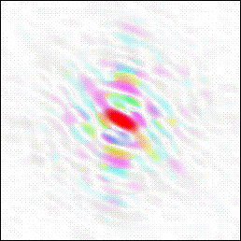
Fourier Duck and Cat
Next tweak the model. Factor of 1/2 occurs because we are making the right correction parallel to the estimated phase, but none perpendicular to the phase. So modify amplitudes (X-ray crystallography technique): |F_{obs}|→2|F_{obs}|-|F_{model}|. Tail comes at full weight, but noise doubled.
Images taken from www.ysbl.york.ac.uk/~cowtan/fourier/fourier.html

Slide 17
What is kurtosis anyway?
Mean, variance, skewness, kurtosis etc. are related to the Fourier transform of the probability density function. For a PDF with a zero mean,
This expression for m_{n} is the familiar one for the n^{th} moment. The first four moments are called mean, variance, skewness, kurtosis.

Slide 18
What is kurtosis anyway?
This treatment can be generalised to the non-zero mean case.
Result: or for non-zero mean,
Together, all the moments contain all the information on the PDF’s shape. (Why?)
ϕ_{x} is known as the characteristic function. Some texts use the moment generating function, but I felt it makes the link to Fourier transform less obvious. It’s defined as:
(How are moments generated from it?)

Slide 19
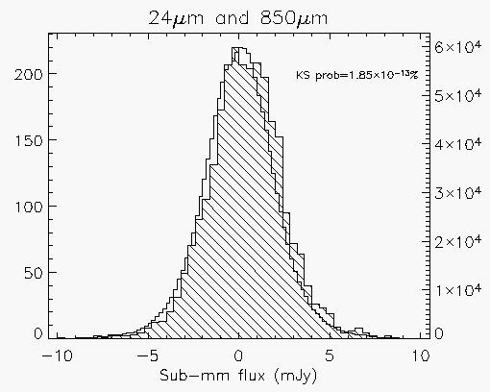
Kolmogorov-Smirnov Test
Is my data set consistent with my model?
Are my two data sets consistent?
number (hatched histogram)
number (un-hatched histogram)
fig. from arXiv:0712.3613

Slide 20
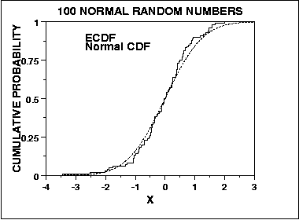
Kolmogorov-Smirnov Test
Comparing the means just compares the first moments; KS uses more information
KS test compares cumulative distributions of data and model, or those of two data sets.
Astonishingly the KS test is asymptotically distribution-free, meaning that for big enough data sets, the result doesn’t depend on the shape of the underlying distribution.
IDL: ksone.pro (data vs. model) & kstwo.pro (data1 vs. data2)
Matlab: kstest & ranksum
Python: scipy.stats.ks_2samp & scipy.stats.kstest
See also Anderson-Darling test
fig. from www.itl.nist.gov
Calculate maximum distance D_{max} between data and model cumulative histograms. Pr(D_{max}, n) is a known function.

Slide 21
Kolmogorov-Smirnov Test
Example: stacking analysis. Does my new deep image manage to detect some galaxies I’ve detected before?
Can calculate mean flux at the galaxies’ positions (error from Central Limit Theorem):
Also use KS test. Suppose galaxy positions are in IDL arrays x, y
fig. from arXiv:0712.3613
IDL> data_on_my_galaxies = image[x,y]
IDL> kstwo, data_on_my_galaxies, image, dmax, prob
IDL> print, prob

Slide 22
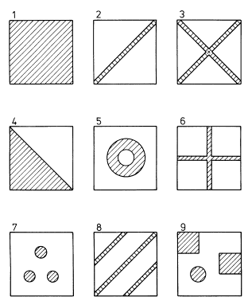
2-D Kolmogorov-Smirnov Test
Four ways of making cumulatives. Choose any one...
Significance levels have been estimated using Monte Carlo simulations; unlike 1-D test, method is not based on analytic theory
‘Very nearly’ distribution-free: almost all the cases to the right give virtually identical results for sufficiently large samples
See Peacock 1983 MNRAS 202, 615 for details
Fig. from Peacock 1983 MNRAS 202, 615

Slide 23
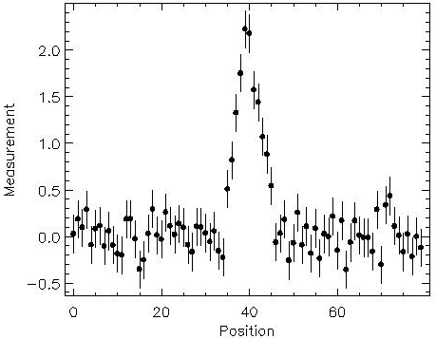
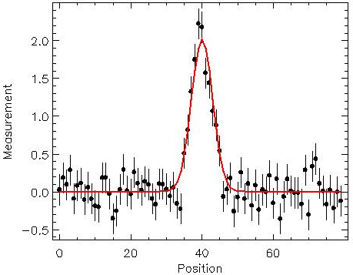
Matched filters
Suppose we know there are features with Gaussian profiles in our data stream, with a known σ but unknown amplitude.
What’s the best-fit profile for an object centred here?
Just minimise

Slide 24
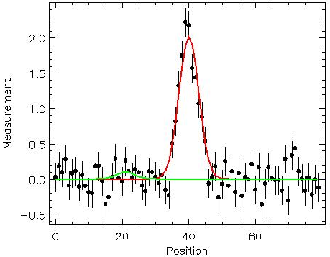
Matched filters
What about the best-fit profile for an object centred here?
Same again - just minimise using a profile
centred somewhere else. We’ll call this profile p₂.

Slide 25
Matched filters
What about having an array which gives you the best-fit profile for an object centred anywhere? This time, use a new profile P which is N pixels wide:
If N(x)=constant then A is just proportional to D⊗P
This is a minimum-variance (lowest noise) estimator for A
Note sum is now over i not x

Slide 26
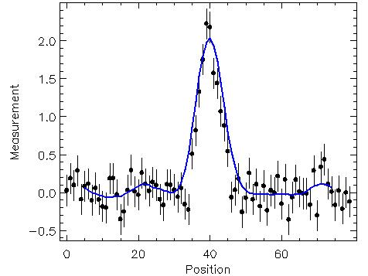
Matched filters
So, ‘smoothing’ is related to ‘finding the best fit everywhere’
Top image shows best-fits for two positions
Bottom image shows best fit amplitude for all positions
Why is the blue curve systematically higher in the middle than the data points?
Generalised to 2-D and N(x)≠constant, e.g. Serjeant et al. 2003 MNRAS 344, 887
Min χ² does not necessarily mean the χ² is any good!

Slide 27
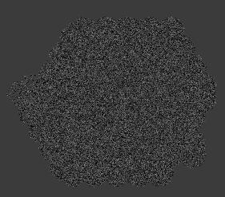
Matched filters
2-D example: SHADES 850μm image of the Subaru-XMM Deep Field
Image greyscales from -2σ to 6.6σ
Signal-to-noise histogram shows
the noise is realistic (histogram is roughly a Gaussian with zero mean and unit variance)
an excess at positive fluxes, due to the objects in the field
Before matched filter
Images from data analysed in Mortier et al. 2005 MNRAS 363, 563; combines images with several PSFs

Slide 28
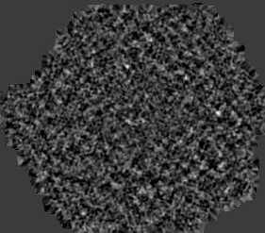
Matched filters
2-D example: SHADES 850μm image of the Subaru-XMM Deep Field
Image greyscales from -2σ to 6.6σ
Signal-to-noise histogram shows
the noise is realistic (histogram is roughly a Gaussian with zero mean and unit variance)
an excess at positive fluxes, due to the objects in the field
After matched filtering by point spread functions*
6.6σ source (honest!)
* PSF = instrumental resolution = response of detector to an unresolved (delta-function) object
Images from data analysed in Mortier et al. 2005 MNRAS 363, 563; combines images with several PSFs

Slide 29
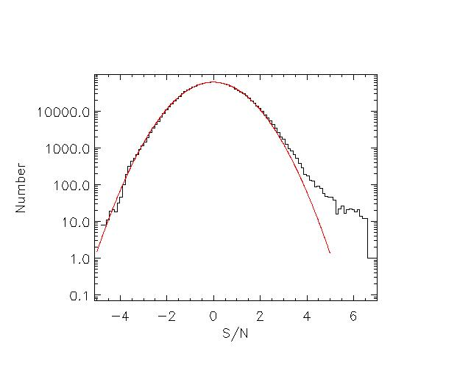
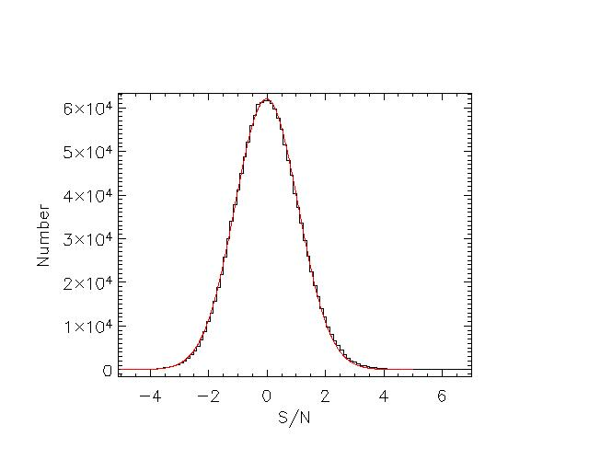
Matched filters
2-D example: SHADES 850μm image of the Subaru-XMM Deep Field
Image greyscales from -2σ to 6.6σ
Signal-to-noise histogram shows
the noise is realistic (histogram is roughly a Gaussian with zero mean and unit variance)
an excess at positive fluxes, due to the objects in the field
Signal-to-noise of matched filtered image*
* Noise on filtered image can be calculated by propagating errors on D⊗P, e.g. Serjeant et al. 2004 MNRAS 344, 887; Mortier et al. 2005 MNRAS 363, 563
Images from data analysed in Mortier et al. 2005 MNRAS 363, 563; combines images with several PSFs

Slide 30
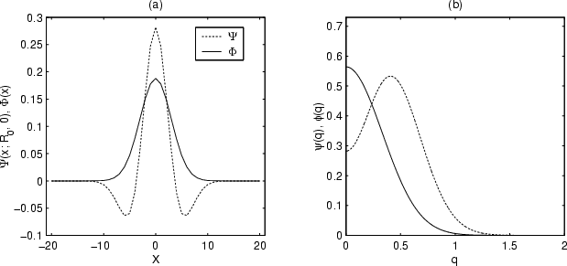
Matched filters on clumpy backgrounds
Real space
Fourier space
Note negative side-lobes give a local sky subtraction; similar to (or in some cases identical to) Mexican Hat Wavelet - see later.
See e.g. Vio et al. 2002 A&A 391, 789
NB minimum-variance does not necessarily mean highest-reliability or highest-completeness

Slide 31
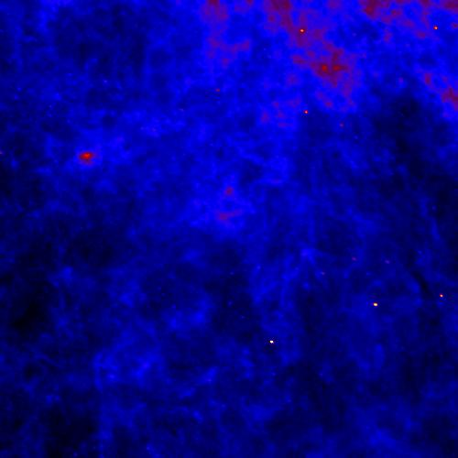
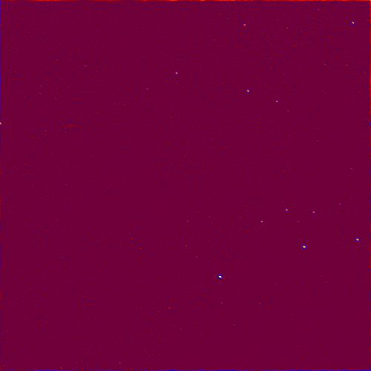
Matched filters on clumpy backgrounds
IRAS 60μm sample data
Figs. by Ho Seong Hwang

Slide 32
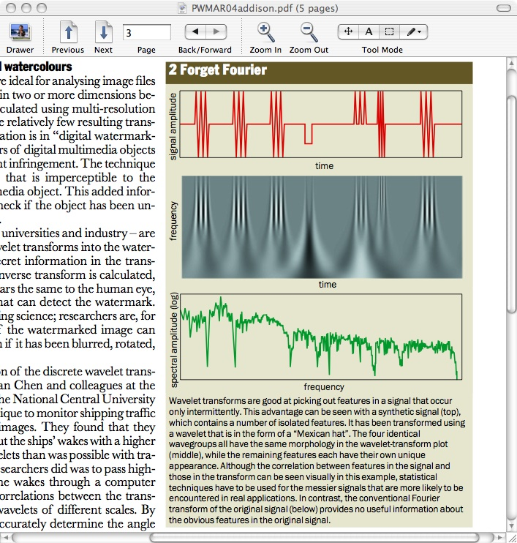
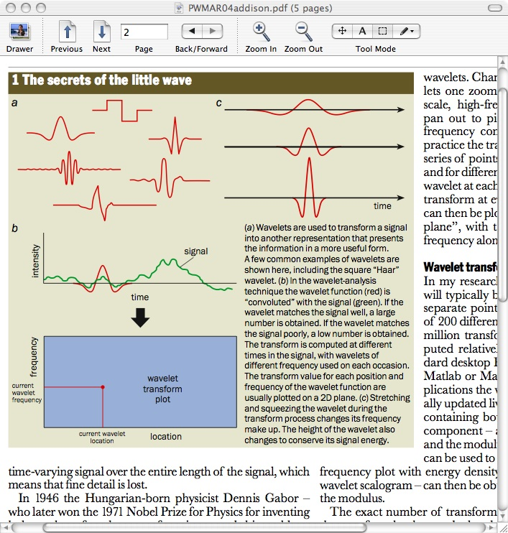
Multi-resolution techniques
Convolve time stream with progressively bigger kernel
Stack these 1-D convolved signals to make a 2-D image
Look for features in this 2-D plane
Advantage over Fourier analysis: sharp changes are localised in position as well as frequency
www.amara.com/current/wavelet.html
Figures from P. Addison, Physics World, March 2004

Slide 33
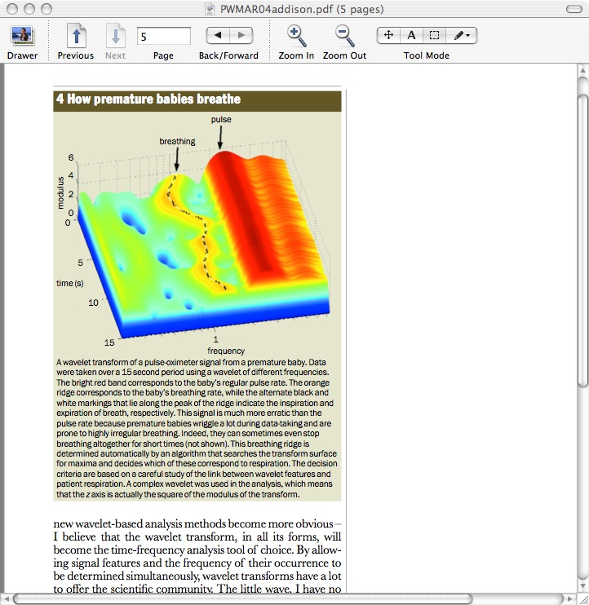
Multi-resolution techniques
Figures from P. Addison, Physics World, March 2004

Slide 34
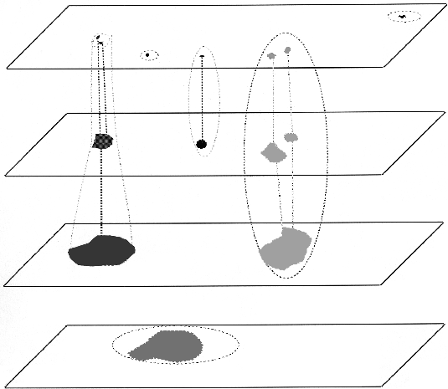
Multi-resolution techniques
Starck et al. 1999 A&AS 138, 365 used a boxcar median filter rather than a convolution kernel
They also use differences from scale to scale, rather than the measurements themselves at each scale (a very effective touch)
Multi-resolution decomposition of images ⇒ 3-D data cube in which features are identified
Fig. from Starck et al. 1999 A&AS 138, 365

Slide 35
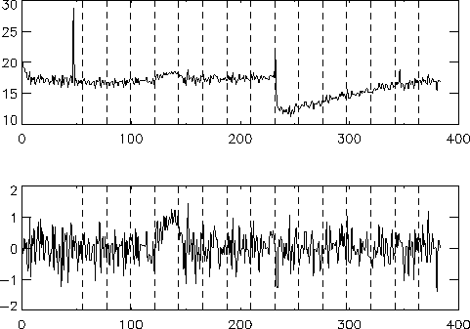
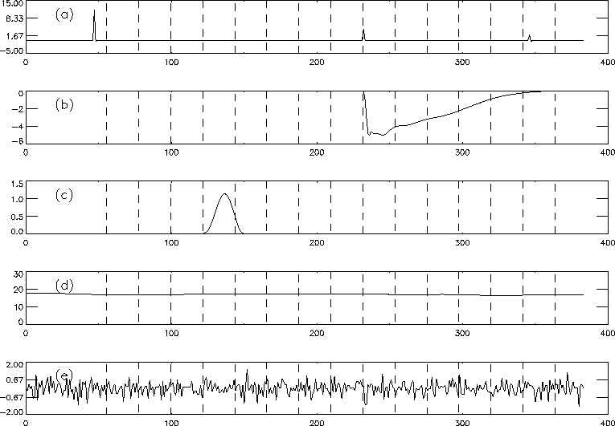
Multi-resolution techniques
This data stream from one pixel...
...is decomposed into its components...
...unwanted signals are removed (detector glitches) leaving this cleaned signal:
Figs. from Starck et al. 1999 A&AS 138, 365

Slide 36
Multi-resolution techniques
Amara Graps has an excellent wavelet page www.amara.com/current/wavelet.html with links to:
Mathcad wavelet extension pack
Mathematica wavelet programs
IDL wavelet utilities in IDL Wavelet Toolkit (add-on to IDL)
Python: PyWavelets: https://pywavelets.readthedocs.io

Slide 37

https://ece.duke.edu

Slide 38
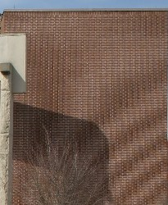
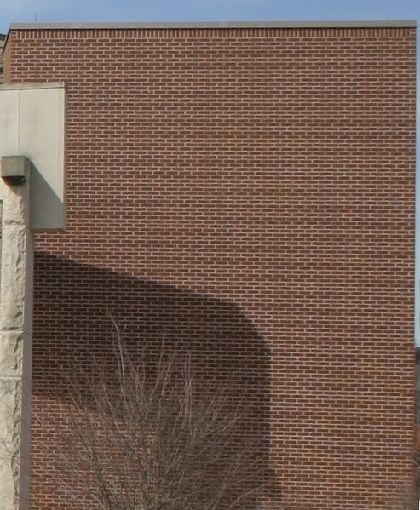
Sampling theory
Nyquist-Shannon sampling theory:
Suppose a function f(x) has a Fourier transform F(k) that is zero above some scale k>k₀
Then f can be completely specified if it is sampled at regular intervals no wider than (2k₀)⁻¹ (Nyquist sampling)
⇒ Astronomers’ pixels are usually ~half the FWHM or smaller
Sampling more coarsely than this (“undersampling”) loses information & can create artefacts
Undersampled detectors (e.g. HST WFC, SCUBA) need dithering
Finer sampling than Nyquist referred to as “oversampling”
Images from wikipedia.org/wiki/Moire

Slide 39
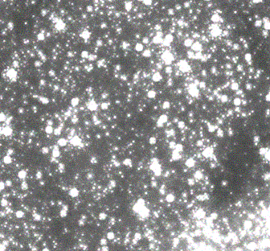
Confusion limit
Sufficiently deep astronomical images are a crowded field of blended sources
RMS from this ‘background’ dominated by objects with number density of about 1 per point spread function
Effective limit for source extraction is determined by the desired significance (e.g. 3σ, 5σ) and number counts dN/dS
In astronomy, usually 1 source per 20-40 beams is reasonable for a 5σ confusion-limited catalogue
Fig. shows NICMOS image of the Galactic Centre, from ssc.spitzer.caltech.edu. See e.g. Condon 1974 ApJ 188, 279; Väisänen et al. 2001 MNRAS 325, 1241 & refs. therein

Slide 40
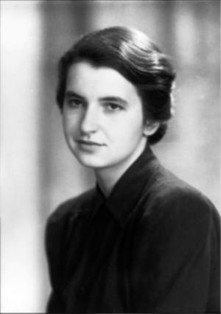

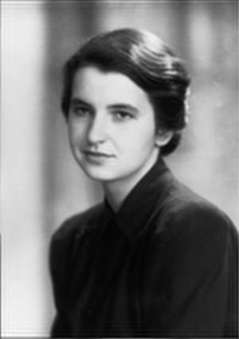
Deconvolution
Convolution is also equivalent to changing the amplitudes of shortest-wavelength Fourier components
Process is reversible (if you can × then you can ÷)
Why not apply it to real data by just beefing up the high-frequency Fourier components?
Image of Rosalind Franklin blurred by convolving with kernel (sum over pixels), then restored by amplifying some high-frequency Fourier components
Initial image adapted from figure at primezero.com

Slide 41
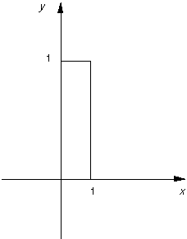

The link between Fourier transform and telescope PSF
The RF deconvolution assumed a Gaussian PSF, which retains high-frequency structure, unlike Airy function. Need to use more realistic PSFs
2
( )
F.T.
= Airy
There is no Fourier information on smaller scales in Sinc or Airy functions

Slide 42
The link between Fourier transform and telescope PSF
The RF deconvolution assumed a Gaussian PSF, which retains high-frequency structure, unlike Airy function. Need to use more realistic PSFs
= Airy
2
( )
F.T.
There is no Fourier information on smaller scales in Sinc or Airy functions

Slide 43
The link between Fourier transform and telescope PSF
The RF deconvolution assumed a Gaussian PSF, which retains high-frequency structure, unlike Airy function. Need to use more realistic PSFs
= Airy
2
( )
F.T.
There is no Fourier information on smaller scales in Sinc or Airy functions

Slide 44
The link between Fourier transform and telescope PSF
The RF deconvolution assumed a Gaussian PSF, which retains high-frequency structure, unlike Airy function. Need to use more realistic PSFs
= Airy
2
( )
F.T.
There is no Fourier information on smaller scales in Sinc or Airy functions

Slide 45
The link between Fourier transform and telescope PSF
The RF deconvolution assumed a Gaussian PSF, which retains high-frequency structure, unlike Airy function. Need to use more realistic PSFs
= Airy
2
( )
F.T.
There is no Fourier information on smaller scales in Sinc or Airy functions

Slide 46
The link between Fourier transform and telescope PSF
The RF deconvolution assumed a Gaussian PSF, which retains high-frequency structure, unlike Airy function. Need to use more realistic PSFs
= Airy
2
( )
F.T.
There is no Fourier information on smaller scales in Sinc or Airy functions

Slide 47
The link between Fourier transform and telescope PSF
The RF deconvolution assumed a Gaussian PSF, which retains high-frequency structure, unlike Airy function. Need to use more realistic PSFs
= Airy
2
( )
F.T.
There is no Fourier information on smaller scales in Sinc or Airy functions

Slide 48
The link between Fourier transform and telescope PSF
The RF deconvolution assumed a Gaussian PSF, which retains high-frequency structure, unlike Airy function. Need to use more realistic PSFs
= Airy
2
( )
F.T.
There is no Fourier information on smaller scales in Sinc or Airy functions

Slide 49
The link between Fourier transform and telescope PSF
The RF deconvolution assumed a Gaussian PSF, which retains high-frequency structure, unlike Airy function. Need to use more realistic PSFs
= Airy
2
( )
F.T.
There is no Fourier information on smaller scales in Sinc or Airy functions

Slide 50
The link between Fourier transform and telescope PSF
The RF deconvolution assumed a Gaussian PSF, which retains high-frequency structure, unlike Airy function. Need to use more realistic PSFs
= Airy
2
( )
F.T.
There is no Fourier information on smaller scales in Sinc or Airy functions

Slide 51
The link between Fourier transform and telescope PSF
The RF deconvolution assumed a Gaussian PSF, which retains high-frequency structure, unlike Airy function. Need to use more realistic PSFs
= Airy
2
( )
F.T.
There is no Fourier information on smaller scales in Sinc or Airy functions

Slide 52
The link between Fourier transform and telescope PSF
The RF deconvolution assumed a Gaussian PSF, which retains high-frequency structure, unlike Airy function. Need to use more realistic PSFs
2
( )
F.T.
= Airy
There is no Fourier information on smaller scales in Sinc or Airy functions

Slide 53

Spitzer 24μm image of the GOODS-N field. Very high signal-to-noise and essentially at the diffraction limit.

Slide 54






Deconvolution - what went wrong?
IMAGE
PSF
FT
FT
FT
÷
=
3.6μm image of NGC7793, from SINGS survey. PSF (resampled) and data from ssc.spitzer.caltech.edu

Slide 55
Deconvolution - what went wrong?
Moral: need sufficient signal-to-noise in Fourier components
A Gaussian PSF is also a Gaussian in Fourier space so high-frequency components are suppressed by a factor ~exp(-0.5(k/k₀)²)
Even in my Rosalind Franklin deconvolution earlier, digitisation error crept in on the smallest scales so not all Fourier modes could be boosted

Slide 56
The limits of deconvolution
Position of an isolated point source can be found to an accuracy of about θ_{FWHM}/(2×S/N) which tends to zero as S/N→∞ (e.g. Condon 1997 PASP 109, 166)
Arbitrary Fourier-based super-resolution is mathematically possible if noise-free but what if we add noise? Resolution can be improved only by a factor ≈(S/N)^{1/2} (Lucy 1992 AJ 261, 706)
Rayleigh-like argument by Lucy 1992 AJ 104, 1260 & Lucy 1992 A&A 261, 706: can we resolve an equal-component double star in a deconvolved image?
Distinguishing one star vs. two stars depends on the image dipole. Its measurement scales as (S/N)^{1/4}.
What about distinguishing a double star from an extended object?
This is a quadrupole measurement, scaling as (S/N)^{1/8}.
These are formidable barriers! But gains appear better if assuming a model (e.g. quasar host galaxies, gravitational lenses).

Slide 57

The limits of deconvolution
Cloverleaf quasar observed with ESO 2.2m telescope (figure from Magain et al. 1998 ApJ 494, 472). Left: observed image with FWHM 1.3’’. Right: deconvolved image with 0.5’’ resolution, made assuming the image is made of a number of point sources. But note that we don’t necessarily have information at 0.5’’ resolution everywhere in the image.

Slide 58
A very fast whizz through some deconvolution tools

Slide 59
CLEAN deconvolution
Interferometry only samples a small part of the Fourier plane (known as u-v plane in astronomy). This means the point spread function has lots of features (“dirty beam”) unlike desired Gaussian or Airy function (“clean beam”)
Radio telescopes collect both amplitudes and phases (unlike e.g. X-ray crystallography which is just amplitudes)
CLEAN uses iterative model to predict amplitudes and (for interferometry) phases:
find peak in dirty image
subtract dirty beam scaled by peak strength and (user-selected) loop gain
add corresponding source to model (initially empty)
go to 1 unless any remaining peak is below user-selected threshold
convolve model with desired clean beam, and add to residual map
TL;DR: iterative modelling, chip away at data and slowly add to model

Slide 60

CLEAN deconvolution
Recall stripy blurring in Fourier Duck when Fourier coverage incomplete
Images from Jackson 2006 presentation at Elba workshop, available at www.arcetri.astro.it/~elba06/SCI_LEC/Jackson.pdf
Description of CLEAN (previous slide) from Saunders 2002 presentation at 2nd APC workshop, available at www.apc.univ-paris7.fr/APCP7_new/aapc/atelier2002.html

Slide 61

CLEAN deconvolution
Images from Jackson 2006 presentation at Elba workshop, available at www.arcetri.astro.it/~elba06/SCI_LEC/Jackson.pdf

Slide 62

CLEAN deconvolution
Images from Jackson 2006 presentation at Elba workshop, available at www.arcetri.astro.it/~elba06/SCI_LEC/Jackson.pdf

Slide 63

CLEAN deconvolution
Images from Jackson 2006 presentation at Elba workshop, available at www.arcetri.astro.it/~elba06/SCI_LEC/Jackson.pdf

Slide 64
Richardson-Lucy deconvolution
Assume the data d_{i} and the true sky s_{j} are related by the point spread function p_{ij}:
Using Bayes’ Theorem, can derive an iterative scheme for finding the most probable model for the sky u_{j}:
The result of each iteration is used to make a prior for the next one
No general convergence proof but works well in simulations. See e.g. Lucy 1974 AJ 79, 745; Richardson 1972 JOSA 62, 55
TL;DR: iterative modelling, Bayesian

Slide 65

Richardson-Lucy deconvolution
Implemented in IRAF: stsdas.contrib.plucy
IDL implementation part of NICMOS library
Matlab: deconvlucy.m in image toolbox
Starlink: LUCY
Python: skimage.restoration.richardson_lucy
Fig. from White 1994 SPIE 2198, 1342 of RL deconvolution of HST image of Saturn. White also discusses noise reduction in RL deconvolution.

Slide 66
Maximum Entropy deconvolution
Another Bayesian technique
Aim is to minimise a “smoothness” function proportional to the Shannon entropy, i.e. to find the minimum information content (defined in the Shannon sense) that is consistent with the data
This method finds an image b which is as close as is allowed by the data to a prior estimate m (subject to the constraint that χ² equals its expected value):
See e.g. Cornwell & Evans 1985 A&A 143, 77
Noise analysis possible (unlike CLEAN)
TL;DR: Bayesian model, maximises 'smoothness' of model
Shannon’s original 1948 paper on entropy and information is accessibly written and is available at http://www-db-out.research.bell-labs.com/cm/ms/what/shannonday/shannon1948.pdf

Slide 67


Maximum Entropy deconvolution
IRAF implementation: mem0c (in contributed software at iraf.noao.edu)
IDL: max_entropy.pro in ASTROLIB
Python: scipy.maxentropy
Many other implementations available
Figures from www.bialith.com

Slide 68


Emerson-II deconvolution
TL;DR: use differing observations to fill in missing Fourier data
Submm astronomical observations often “chopped” to help sky subtraction (sky is often ~10⁵-10⁶ times brighter than targets of interest)
Fourier modes on chop scale therefore lost
Figs. from Jenness et al. 2000 ASP 216, 559, available at www.adass.org/adass/proceedings/adass99/P2-56/ and from SUN216 available at starlink.rl.ac.uk

Slide 69

Emerson-II deconvolution
Solution: use a variety of chop lengths and angles
Fourier modes lost from one image can be obtained from another
Images combined in Fourier space then transformed back
See e.g. Jenness et al. 2000 ASP 216, 559
Combined image
Figures from SUN216 available at starlink.rl.ac.uk

Slide 70
MADMAP
Assume detector is scanning across the sky, with n_{t} time samples at n_{s} spatial positions
Assume data time stream d has fluctuations n from piecewise stationary Gaussian noise (which can include 1/f noise)
Define matrix A of size n_{t}×n_{s} to map positions as a function of time onto the sky positions.
Define time-time noise covariance matrix of data to be matrix N (dimensions n_{t}×n_{t})
Then: d = n + As
This has maximum-likelihood solution for the sky image:
m = (A^{T}N ⁻¹A)⁻¹A^{T}N ⁻¹d
MADMAP solves this equation. It was developed for CMB map reconstruction - see http://crd.lbl.gov/~cmc/MADmap/doc/
TL;DR: matrix inversion method – isolate stuff that stays the same (things on the sky) from stuff that doesn't (artefacts)

Slide 71

MADMAP
Image shows simulated data from Herschel Space Observatory (Waskett et al. 2007 MNRAS 381, 1583)
Two scan directions used
Detector has long timescale drifts that can be seen in the scan directions
MADMAP isolates the true sky signal (invariant with position) from the artefacts (which depend on scan time and not sky position)
NB enough multiple observations (“redundancy”) and all noise is gaussian-ized by Central Limit Theorem (essential for SCUBA)

Slide 72

Test your understanding
Ground-based optical telescopes’ resolution limited by seeing (the blurring due to atmospheric turbulence)
In space, no atmosphere ⇒ diffraction limit obtainable
Point spread function is closely related to the Fourier transform of the telescope aperture (from your undergraduate optics)
PSF is Airy function (e.g. recall Fourier Duck’s truncated FT)
F.T.
HST image of star GGTau and its companion (logarithmic greyscale). Diffraction spikes etc. caused by e.g. struts in HST’s optics
Figs from www.cs.cf.ac.uk/Dave/Vision_lecture/Vision_lecture_caller.html and Krist et al. 2005 AJ 130, 2778

Slide 73
Test your understanding
Spitzer 24μm image of the GOODS-N field (left) is very high S/N and essentially at the diffraction limit. Can you use a Fourier-based deconvolution to increase the resolution? Assume the PSF is an Airy function.

Slide 74
Summary
Moments of a PDF contain all the information on the PDF's shape
Try statistics that use more than just the first moment, e.g. Kolmogorov-Smirnov
“Finding the min-χ² model everywhere” is equivalent to convolution
Convolution itself equivalent to a multiplication in Fourier space
Diffraction in astronomy is very closely related to Fourier transforms
Many useful techniques are available for restoring the information suppressed in convolution
Impressive results can be had from model-dependent deconvolution but don’t forget the model dependence

Slide 75
Last thoughts
60% of people believe in God (UK MORI poll 2003, www.ipsos-mori.com/polls/2003/bbc-heavenandearth.shtml)
64% of people don’t trust statistics (UK ONS poll 2008, www.statistics.gov.uk/pdfdir/pco0308.pdf)
88.2% of statistics are made up on the spot (Vic Reeves, news.bbc.co.uk/1/hi/uk/859476.stm)

